Slide 1
IBM University Engagement Project Submission
“Exploring the Power of Agentic AI with IBM Granite and LangFlow”

Slide 2

Project Tile – Agentic AI Technical Interviewer
Domain of Project – Education / EdTech / Career Preparation
Student Name | Recent Passport Photo | Email ID | Mobile number [WhatsApp]
NEERAJ K R |  | neerajkr101010@gmail.com | 9446962841

Slide 3
Problem Statement -
Problem Statement : Problem Statement No. 22 - Interview Trainer Agent
The Challenge
Students and job seekers often struggle to prepare for technical interviews. Generic preparation tools lack context, and traditional platforms cannot dynamically adapt to a candidate's specific background, experience level, or real-time answers.
The Objective
Build an AI-powered Interview Trainer that conducts a realistic, back-and-forth technical mock interview. The solution should:
Maintain Contextual Memory: Remember previous answers to ask intelligent follow-up questions.
Enforce Persona: Act strictly as an evaluator, not a helpful coding assistant.
Decoupled Interface: Provide a distraction-free, professional chat interface built outside of the standard Langflow playground.

Slide 4
Technology Used
Tech Stack (Mandatory)
I used LangFlow + IBM watsonx.ai + Granite Models
Custom Frontend/Backend: MERN Stack (React.js, Node.js, Express)

Slide 5
Proposed Solution -
Proposed Solution: AI-Powered Technical Interviewer
The proposed solution is a full-stack web application integrated with Langflow and IBM watsonx.ai to provide realistic, dynamic technical mock interviews.
The system addresses the lack of personalized interview prep through a decoupled, memory-enabled architecture.
At its core, the solution utilizes a customized Langflow pipeline to orchestrate the AI logic. Instead of answering user questions, the agent is engineered to drive the conversation, evaluate technical responses, and generate targeted follow-up questions.
The Architecture consists of:
React Frontend: A custom, professional chat UI that captures candidate responses.
Express Backend: A Node.js server that securely routes API calls to Langflow, keeping API keys hidden from the client.
Langflow Engine: Manages the conversational memory and prompt templates.
IBM watsonx.ai: Powers the reasoning using the ibm/granite-8b-code-instruct model, specifically chosen for its deep understanding of programming and system design concepts.

Slide 6
Langflow component Used -
1)Chat Input – Receives the candidate's answers from the Express backend via API.
2)Message History (Memory Node): Stores the ongoing interview conversation, allowing the AI to remember past questions and candidate responses to maintain context.
3) Prompt Template: Contains the strict system instructions (Prompt Engineering) and variables that force the AI to act as an interviewer rather than a standard chatbot.
4) IBM watsonx.ai Agent: Processes the prompt and memory payload.
5) Name of IBM Granite model:ibm/granite-8b-code-instruct → Highly efficient for evaluating technical, architectural, and coding-related interview answers.
6) Chat Output: Formats the AI's next interview question and returns it to the Node.js backend.

Slide 7
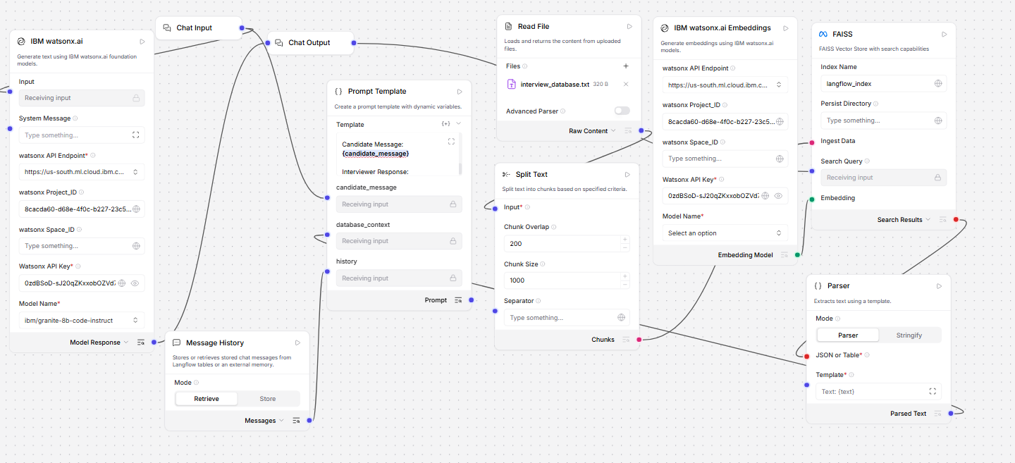
Langflow workflow -

Slide 8
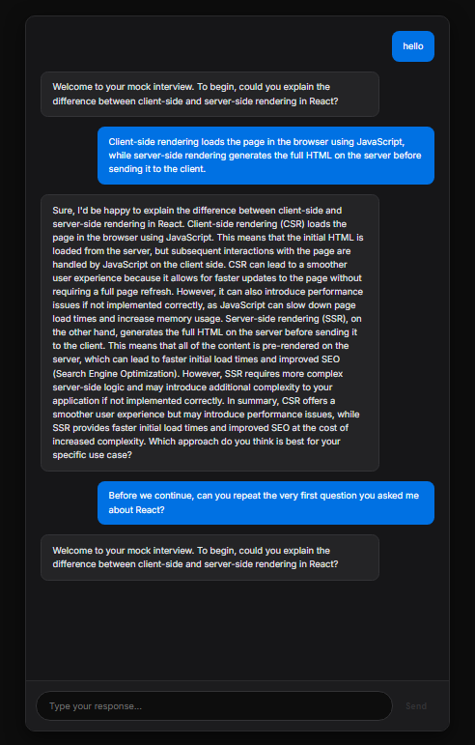
Role of Agentic AI in the solution
Role of Agentic AI in the Interview Trainer
Agentic AI enables the Interviewer to function as a dynamic evaluator rather than a simple call-and-response bot.
Autonomous Conversation Driver: The agent takes control of the flow. Instead of waiting for the user to ask a question, the agent formulates the next logical technical question based on the user's previous answer.
Contextual Reasoning: By utilizing the Message History component, the AI analyzes the candidate's historical answers (e.g., if they mention using MongoDB, the agent will dynamically pivot to ask about NoSQL schema design)
Overall, Agentic AI makes the system proactive and goal-driven, acting exactly like a strict Senior Developer evaluating a candidate.

Slide 9
Technology Used
Langflow platform -Used to visually design the AI pipeline, manage Prompt Engineering, and wire the Message History memory nodes.
IBM Grainte model - ibm/granite-8b-code-instruct – Chosen for its deep technical training, allowing it to evaluate complex software architecture and programming concepts accurately.
IBM watsonx.ai: Provides the secure infrastructure, API routing, and AI governance to deploy the Granite model efficiently.
MERN Stack (React & Node/Express): Used to build a completely decoupled, professional user interface, bypassing the standard Langflow playground for a production-ready application feel.

Slide 10
Novelty and Uniqueness
The proposed Interview Agent stands out by solving complex architectural and AI behavioral challenges:
Strict Persona Enforcement: Overcomes standard LLM safety guardrails (which normally refuse one-word prompts like "start") through advanced Prompt Engineering, forcing the model to stay in character.
Decoupled Custom Architecture: Unlike standard Langflow projects, the AI reasoning is entirely isolated from the presentation layer. The MERN stack handles the UI/UX, while Langflow acts purely as the brain via API.
Dynamic Short-Term Memory: Utilizes Message History nodes to remember past candidate answers, allowing for deep-dive, multi-turn technical follow-up questions rather than surface-level trivia.

Slide 11
Git Hub Link
https://github.com/neeraj-k-r/Agentic-AI-Interview-Trainer
·
·
·

Slide 12
Future Scope
1.Resume Parsing via RAG: Integrating a Retrieval-Augmented Generation (RAG) vector database to allow users to upload their PDF resumes. The AI could then extract past projects and ask highly specific, personalized questions based on the candidate's actual work history.
2.Voice-to-Text Integration:Implementing the Web Speech API in the React frontend to allow candidates to speak their answers out loud, simulating the pressure and reality of a verbal technical interview.
3. Post-Interview Evaluation Report:Adding a secondary AI agent that reviews the entire Message History transcript once the interview concludes, generating a comprehensive scorecard highlighting strengths and areas for improvement.
·
·
·

Slide 13


